Slide 1

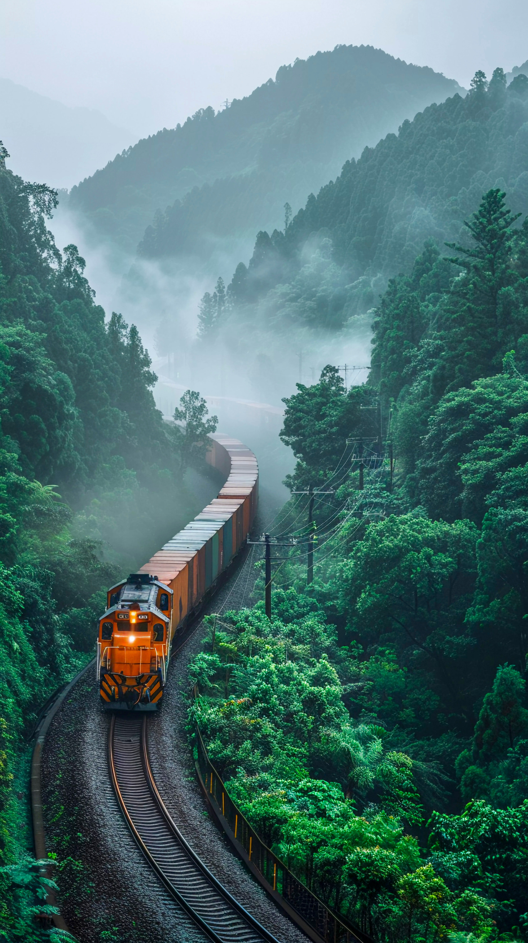


AI Powered Train Safety System with Real-Time Crowd and Obstacle Detection
Group No : 25-26J-134
SLIIT
Faculty of Computing

Slide 2
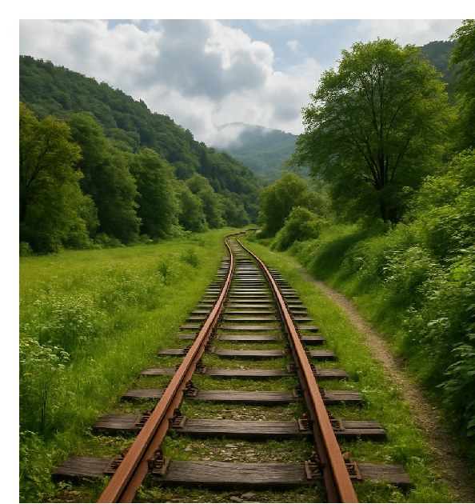
Content
Overview
Design Excellence of the Project
Individual Components
- Compartment Crowd Density Detection
- Platform Compartment Alignment
- Object Detection & Alerting System
- Intelligent Driver Support System
Commercialization
- Uniqueness of the solution
- Market size

Slide 3

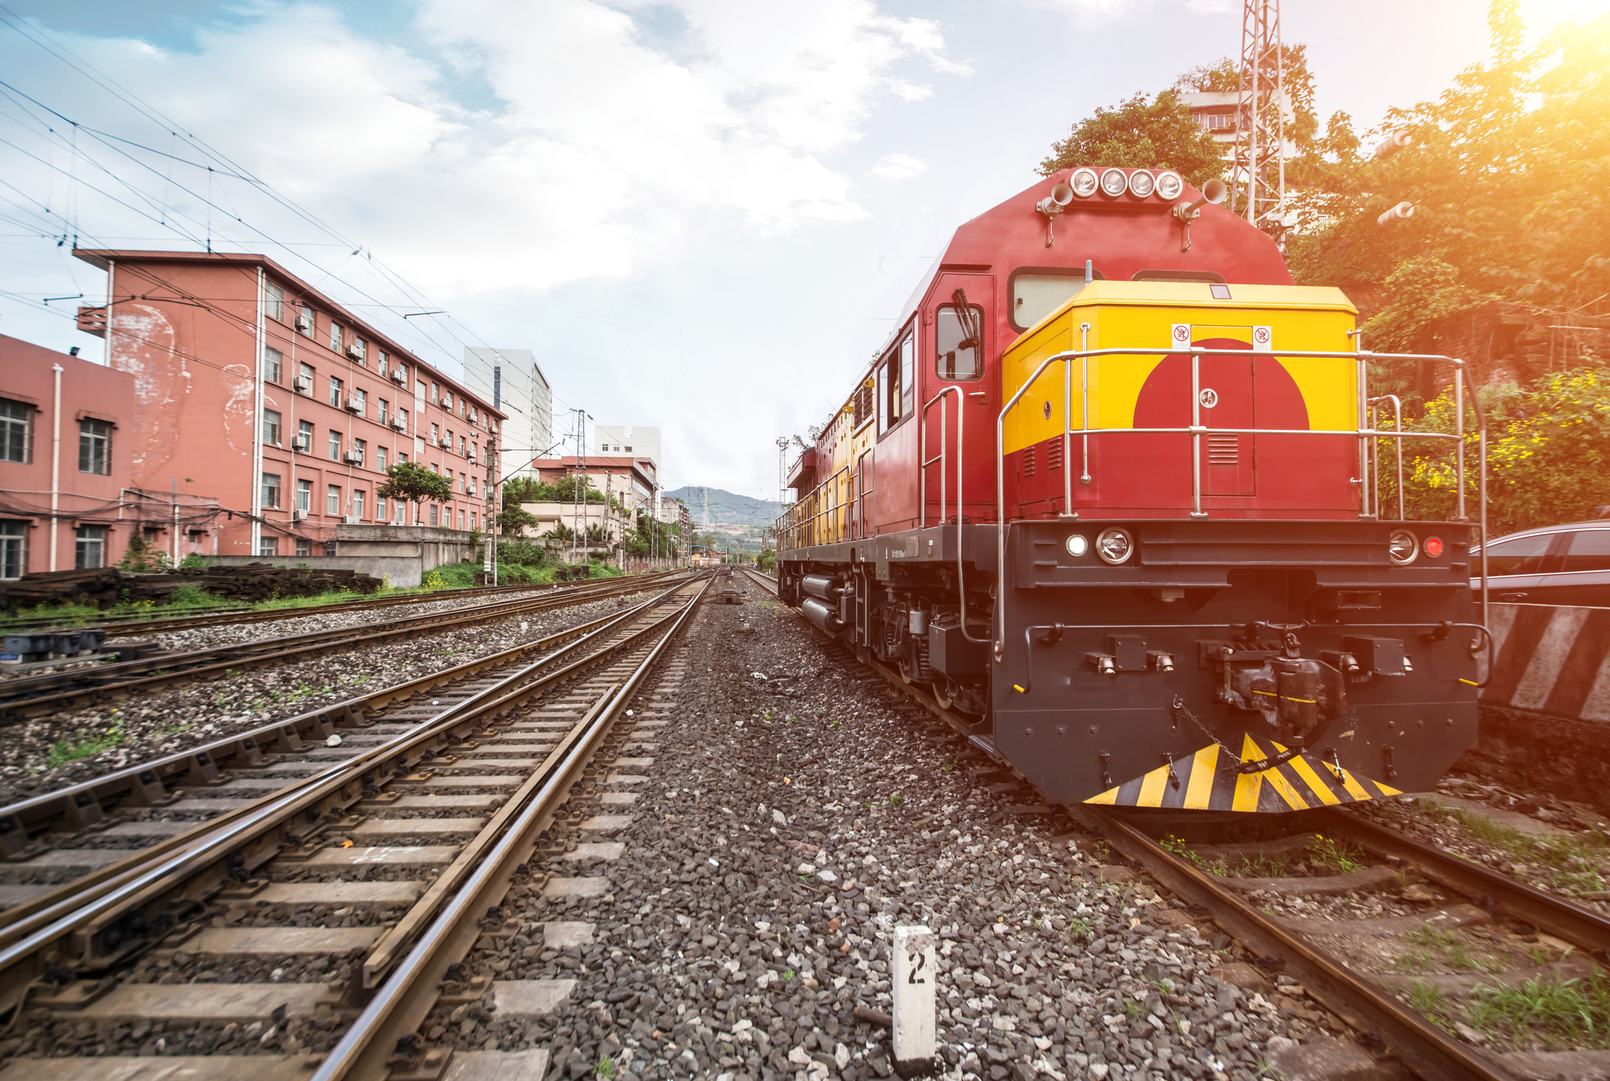
Overview
Problems Identified
Train overcrowding causes unsafe boarding of passengers & delays.
Collisions with humans or animals affects accidents & losses.
No real-time detection of train driver fatigue and drowsiness, increasing accident risk.
Target Group
Railway operators
Train drivers
Station management staff
Impact
Improves passenger flow with real time guidance.
Reduces accidents using smart systems.
Enhances safety management

Slide 4

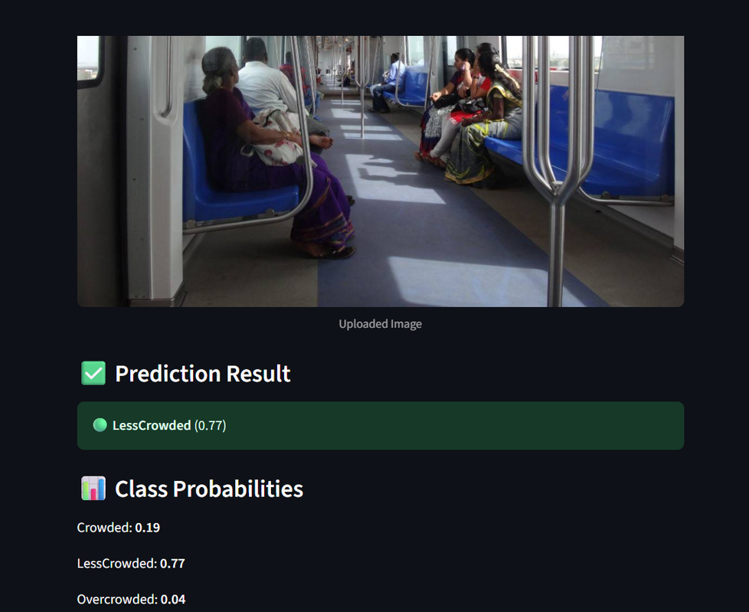
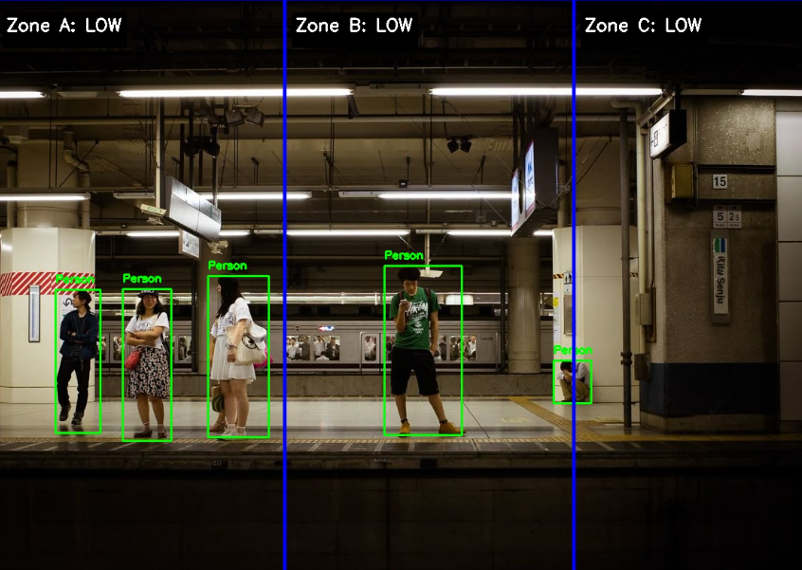
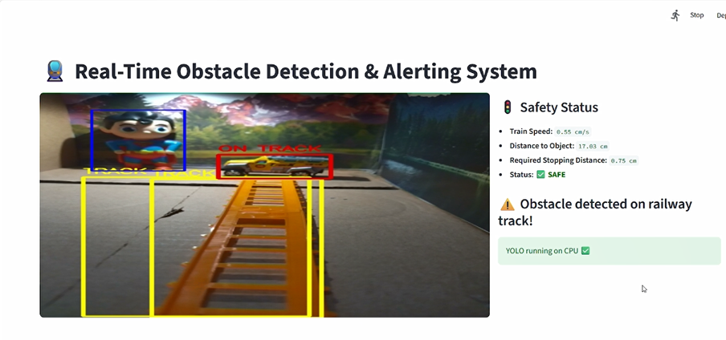
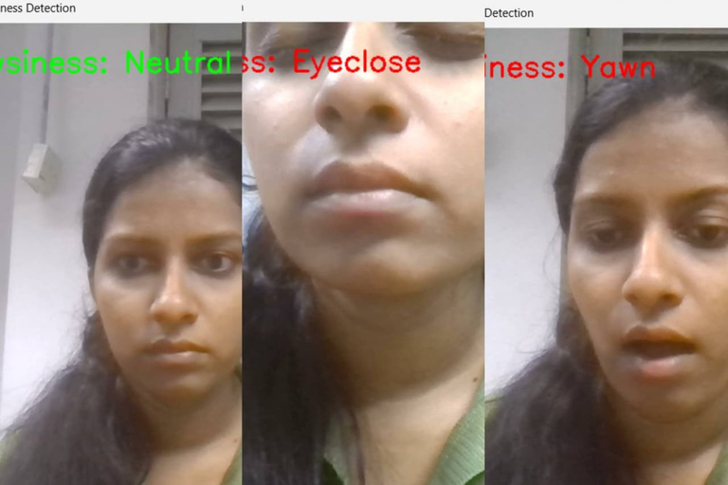
Design Excellance of Overall Project
Compartment Crowd Density Detection
Platform Compartment Alignment
Real-Time Obstacle Detection & Alerting System
Intelligent Driver Support system
Real-time AI processing hub
Privacy-preserving (no identity storage)
Integrates crowd, obstacle & driver safety into one system

Slide 5


Compartment Crowd Density Detection
Udaya Sri A L S
IT22283412
SLIIT
Faculty of Computing
Specialization : Data Science

Slide 6

Compartment Crowd Density estimation
Sub Problem:
Passengers and operators cannot easily identify overcrowded train compartments before boarding.
Solution:
The prototype classifies each train compartment image into three crowd levels.
User Requirements Addressed:
For users:
Users need to quickly identify whether a compartment is overcrowded.
For station operators:
Operators need a fast method to monitor crowd conditions.
The output must be simple and understandable (3-level classification).

Slide 7

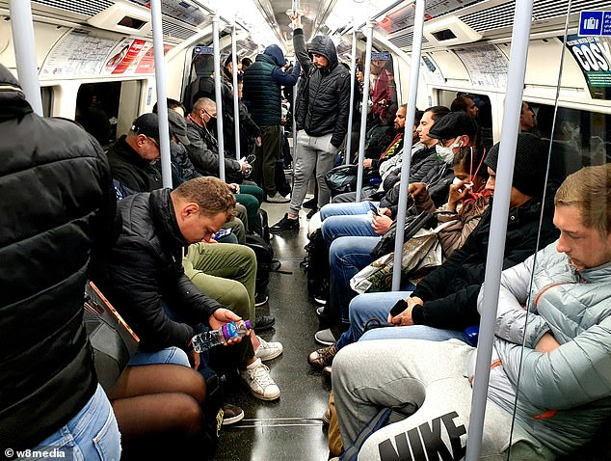
Identified Limitation:
Visual density alone does not always reflect actual usability of space.
Enhanced Solution:
Segment floor, passengers, and seats at pixel level.
Estimate usable free space.
Re-classify crowd level based on actual free space availability
Design Excellence / Contribution:
Generate data by using simulator.
Works on single CCTV images without additional sensors.
Use different approaches to annotate images.
Introduces free-space–aware crowd classification, not just people counting.
Uses semantic segmentation for pixel-level spatial understanding

Slide 8

Platform Compartment Alignment
Bandara I K
IT22250988
SLIIT
Faculty of Computing
Specialization : Data Science

Slide 9
Platform Compartment Alignment
Sub Problem :
Inefficient train-platform alignment causes overcrowding and safety issues
Solution :
Real-time crowd detection using YOLO on platform CCTV footage.
Dynamic alignment optimization matches crowded compartments to less crowded platform zones.
Multi-objective optimization balances crowd distribution, passenger flow, and safety

Slide 10
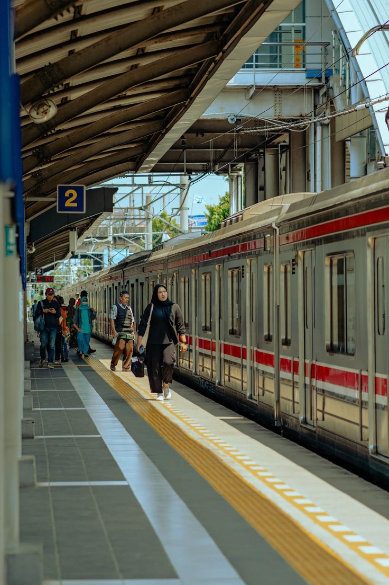
Platform Compartment Alignment
User Requirements :
For Train Drivers
✓ Clear visual guidance on where to stop.
✓ Real-time braking recommendations.
For Station Operators
✓ Platform crowd monitoring across 3 zones with density levels.
✓ Optimization metrics showing alignment quality.
✓ Ensure safety and smooth passenger flow.
Contribution :
Experienced different approaches to create the dataset.
Used hybrid density calculation to detect crowd levels.
Used multi objective cost function for optimization.

Slide 11
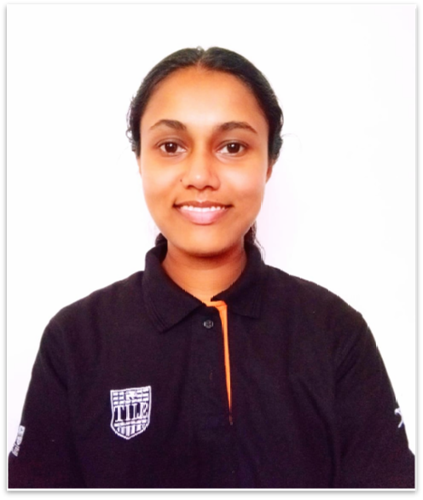
Real-Time Obstacle Detection & Alerting System
Prarthana L D R
IT22291578
SLIIT
Faculty of Computing
Specialization : Data Science

Slide 12
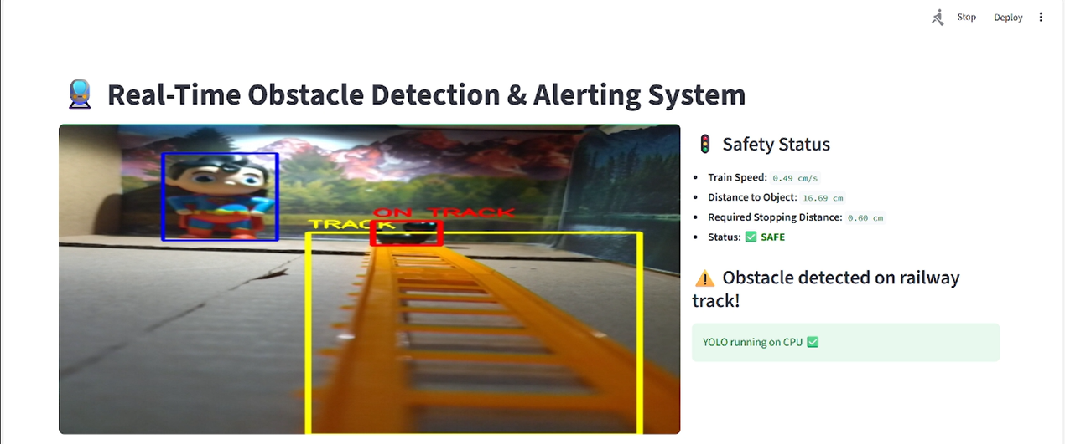
Real-Time Obstacle Detection & Alerting System
Sub Problem :
Train drivers and passengers are affected because obstacles on railway tracks are not detected early, leading to sudden braking, collisions, and unexpected train delays, making it difficult to predict accurate arrival times at the next station.
Solution :
Detects track obstacles early using radar and camera sensors
Measures train speed in real time using Hall Effect sensor
Calculates safe braking distance and triggers alerts to the driver
Predicts updated arrival time to the next railway station after obstacle detection

Slide 13
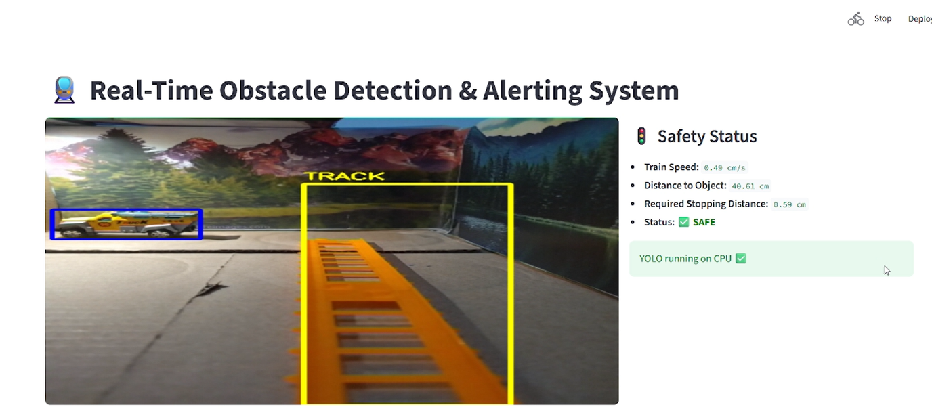
Real-Time Obstacle Detection & Alerting System
User Requirements :
For Train Drivers
Early warning of obstacles on the track
Real-time decision support for braking
Reduced dependence on manual observation
Improved driving safety and confidence
For Station Operators/ Passengers
Advance information on train delays
Accurate prediction of arrival time at the next station
Contribution :
Created dataset using publicly available datasets & custom datasets
Improves railway safety by reducing train–obstacle collisions
Supports drivers with real-time automated alerts
Enhances passenger experience through delay prediction
Integrates safety and operational efficiency in one system

Slide 14

Intelligent Driver Support System
Jayasinghe J M H C
IT22597342
SLIIT
Faculty of Computing
Specialization : Data Science

Slide 15
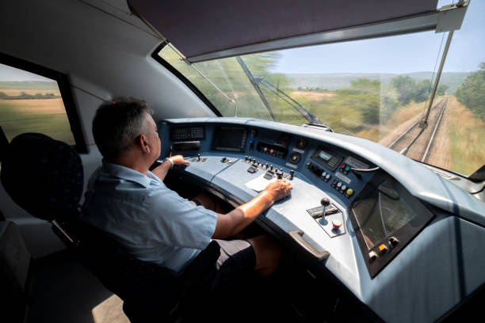
Intelligent Driver support system
Sub-Problem:
Train driver fatigue and drowsiness often go undetected in real time, increasing the risk of accidents.
Single-method detection systems (facial analysis only) lead to false alarms and unreliable performance.
Proposed Solution
A multi-modal fatigue detection system combining facial analysis and sensor-based monitoring.
Detects drowsiness using EAR, MAR, head movement, and heart rate patterns.
Applies machine learning models to classify driver alertness in real time.
Triggers an immediate buzzer alert to prevent potential accidents.

Slide 16
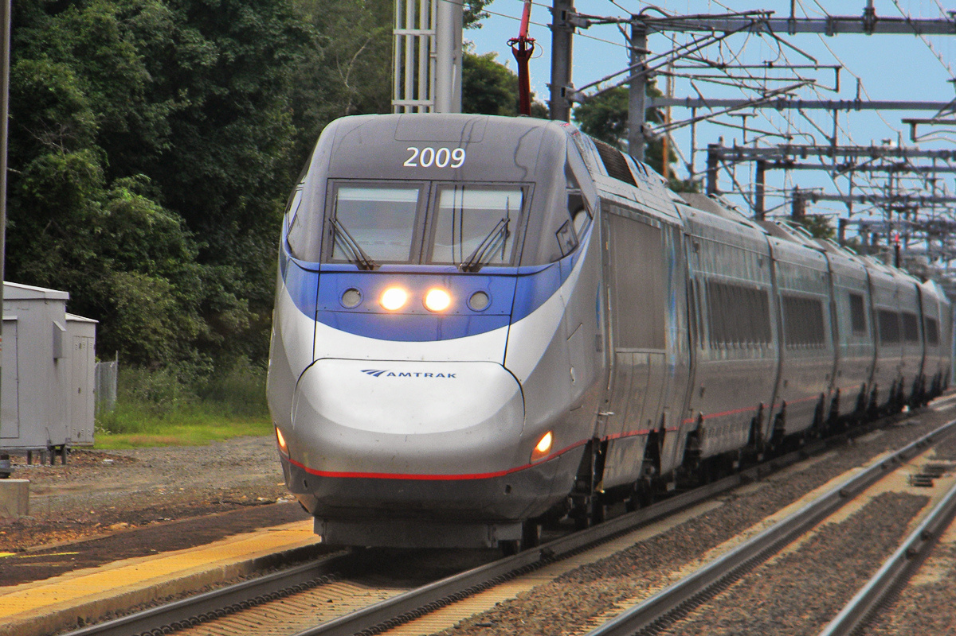
Intelligent Driver Support System
User Requirements
Continuous real-time monitoring of driver alertness.
High accuracy with reduced false detections.
Offline operation without internet dependency.
Fast hardware-level alerts for immediate driver response.
Easy to understand and operate during real-world usage.
Contribution
Designed a multi-modal detection approach using a camera, MPU9250, and pulse sensor.
Implemented an MLP model for facial-feature-based drowsiness detection using MediaPipe and OpenCV.
Implemented a Random Forest model for sensor-based fatigue classification.
Developed Arduino firmware for real-time sensor data acquisition and alert control.
Integrated Python–Arduino serial communication for live machine learning predictions.

Slide 17

AI POWERED TRAIN SAFETY SYSTEM WITH REAL-TIME CROWD AND OBSTACLE DETECTION
Commercialization
Customer Persona
Market Size
Deployable as an add-on intelligent safety system for existing railway infrastructure
Uses CCTV, reducing installation and maintenance cost
Scalable across stations, compartments, and trains
Improves safety, punctuality, and passenger experience, ensuring long-term adoption
Railway authorities & transport ministries
Train operating companies
Station operators and control centers
Urban metro and suburban rail systems
Growing global demand for railway safety and smart transportation systems
High relevance in high-density passenger rail networks
Strong adoption potential in both developing and developed countries

Slide 18

What is Unique in our Solution
Integrated end-to-end intelligent railway system
Combines:
Crowd density estimation & platform alignment optimization
Obstacle detection & delay prediction
Intelligent driver tiredness detection
Uses AI + sensor fusion + optimization in a single framework
Focuses on both safety and operational efficiency, not just accident prevention
Cost Recovery
System licensing to railway operators
Deployment and customization contracts
Maintenance and software update services
Government safety modernization funding and grants

Slide 19
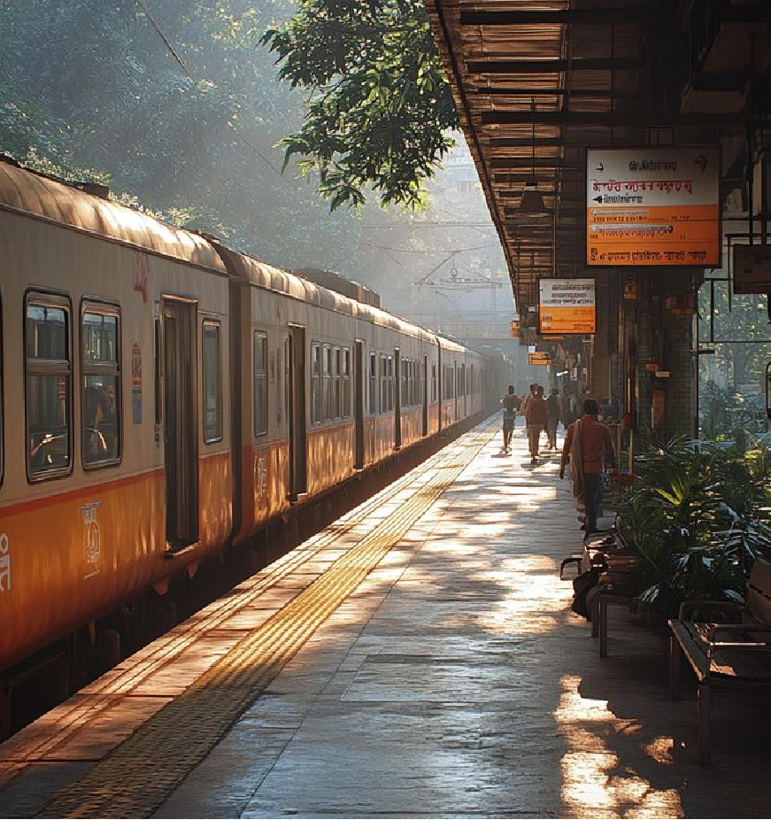
THANK YOU..!

